Slide 1









Simposio SSMIG-TI/ATIMEF del 13 novembre 2025, i nostri sponsor

Slide 2




Simposio SSMIG-TI/ATIMEF del 13 novembre 2025, i nostri sponsor

Slide 3


SSMIG-TI
Assemblea generale ordinaria
13 NOVEMBRE 205
Sala Conferenze-H. Principe Leopoldo
6900 Lugano
Notes:
_________________________________________________________________________________________________________________________________________________________________________________________________________________________________________________________________________________________________________________________________________________________________________________________________________________________________________________________________________________________________________________________________________________________________________________________________________________________________________________________________________________________________________________________________________________________________________________________________________________________________________________________________________________________________________________________________________________________________________________________________________________________________________________________________________________________________________________________________________________________________________________________________________________________________________________________________________________________________________________________________________________________________________________________________________________________________________________________________________________________________________

Slide 4
ASSEMBLEA GENERALE TRATTANDE
              SALUTO DEL PRESIDENTE OMCT
              DR.MED. FRANCO DENTI
              RELAZIONE DEL PRESIDENTE
Notes:
_________________________________________________________________________________________________________________________________________________________________________________________________________________________________________________________________________________________________________________________________________________________________________________________________________________________________________________________________________________________________________________________________________________________________________________________________________________________________________________________________________________________________________________________________________________________________________________________________________________________________________________________________________________________________________________________________________________________________________________________________________________________________________________________________________________________________________________________________________________________________________________________________________________________________________________________________________________________________________________________________________________________________________________________________________________________________________________________________________________________________________

Slide 5

SSMIG-TI assemblea generale
MEMBRI DI COMITATO
PRESIDENTE Dr.med Francesca Mainieri
VICEPRESIDENTE Prof.Dr.med Marco Pons
CASSIERE Signora Demetra Colombo
SEGRETARIO Dr.med M. F. Ramsauer
MEMBRO DI COMITATO Dr.med. Loriana Bihl
MEMBRO DI COMITATO Dr.med. Christian Garzoni
MEMBRO DI COMITATO Dr.med. Andrea Farruggia
MEMBRO DI COMITATO Dr.med. Manuela Balmelli
Notes:
_________________________________________________________________________________________________________________________________________________________________________________________________________________________________________________________________________________________________________________________________________________________________________________________________________________________________________________________________________________________________________________________________________________________________________________________________________________________________________________________________________________________________________________________________________________________________________________________________________________________________________________________________________________________________________________________________________________________________________________________________________________________________________________________________________________________________________________________________________________________________________________________________________________________________________________________________________________________________________________________________________________________________________________________________________________________________________________________________________________________________________

Slide 6
SSMIG-TI assemblea generale
Relazione del cassiere Demetra Colombo
PRESENTAZIONE NUOVI MEMBRI
Discussione
Varie ed eventuali
Termine dell’ assemblea
Notes:
_________________________________________________________________________________________________________________________________________________________________________________________________________________________________________________________________________________________________________________________________________________________________________________________________________________________________________________________________________________________________________________________________________________________________________________________________________________________________________________________________________________________________________________________________________________________________________________________________________________________________________________________________________________________________________________________________________________________________________________________________________________________________________________________________________________________________________________________________________________________________________________________________________________________________________________________________________________________________________________________________________________________________________________________________________________________________________________________________________________________________________

Slide 7
SSMIG-TI assemblea generale
PRESENTAZIONE NUOVI MEMBRI
Dr.med. Andrea Ferruggia
Dr. med Luca Sanna
Dr.med. Volha Zhuk
Notes:
_________________________________________________________________________________________________________________________________________________________________________________________________________________________________________________________________________________________________________________________________________________________________________________________________________________________________________________________________________________________________________________________________________________________________________________________________________________________________________________________________________________________________________________________________________________________________________________________________________________________________________________________________________________________________________________________________________________________________________________________________________________________________________________________________________________________________________________________________________________________________________________________________________________________________________________________________________________________________________________________________________________________________________________________________________________________________________________________________________________________________________

Slide 8
SSMIG-TI assemblea generale
RELAZIONE DEL CASSIERE E DEL REVISORE DEI CONTI
SIGNORA DEMETRA COLOMBO
DR.MED. ANASTAS KICK
Notes:
_________________________________________________________________________________________________________________________________________________________________________________________________________________________________________________________________________________________________________________________________________________________________________________________________________________________________________________________________________________________________________________________________________________________________________________________________________________________________________________________________________________________________________________________________________________________________________________________________________________________________________________________________________________________________________________________________________________________________________________________________________________________________________________________________________________________________________________________________________________________________________________________________________________________________________________________________________________________________________________________________________________________________________________________________________________________________________________________________________________________________________

Slide 9
SSMIG-TI assemblea generale
APPROVAZIONE VERBALE ANNO 2024
(REDATTO DA DR.MED: FABRIZIO RAMSAUER)
Notes:
_________________________________________________________________________________________________________________________________________________________________________________________________________________________________________________________________________________________________________________________________________________________________________________________________________________________________________________________________________________________________________________________________________________________________________________________________________________________________________________________________________________________________________________________________________________________________________________________________________________________________________________________________________________________________________________________________________________________________________________________________________________________________________________________________________________________________________________________________________________________________________________________________________________________________________________________________________________________________________________________________________________________________________________________________________________________________________________________________________________________________________

Slide 10
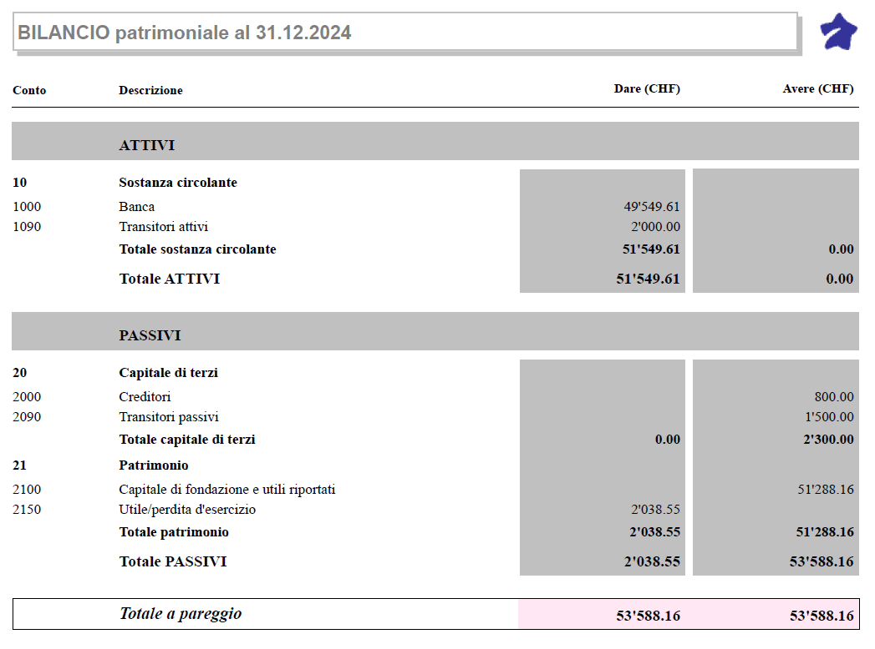
SSMIG-TI assemblea generale
BILANCIO - SIRIO
Notes:
_________________________________________________________________________________________________________________________________________________________________________________________________________________________________________________________________________________________________________________________________________________________________________________________________________________________________________________________________________________________________________________________________________________________________________________________________________________________________________________________________________________________________________________________________________________________________________________________________________________________________________________________________________________________________________________________________________________________________________________________________________________________________________________________________________________________________________________________________________________________________________________________________________________________________________________________________________________________________________________________________________________________________________________________________________________________________________________________________________________________________________

Slide 11
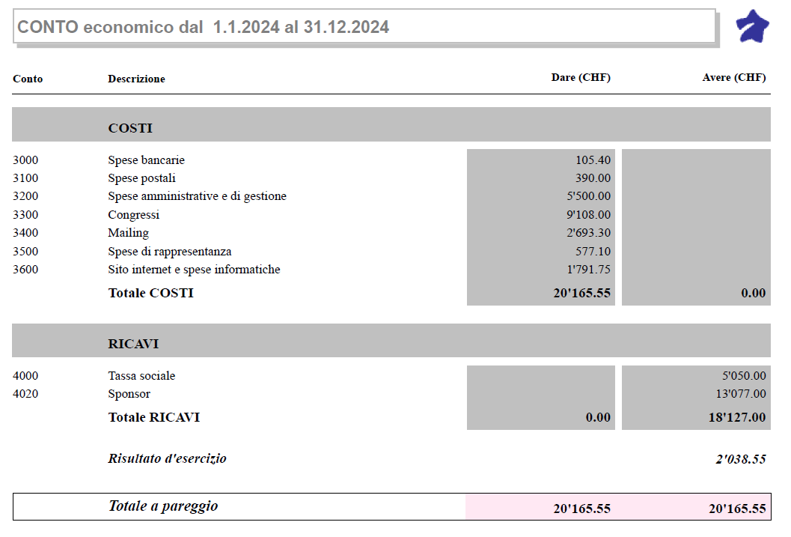
SSMIG-TI assemblea generale
CONTO ECONOMICO – SIRIO
Notes:
_________________________________________________________________________________________________________________________________________________________________________________________________________________________________________________________________________________________________________________________________________________________________________________________________________________________________________________________________________________________________________________________________________________________________________________________________________________________________________________________________________________________________________________________________________________________________________________________________________________________________________________________________________________________________________________________________________________________________________________________________________________________________________________________________________________________________________________________________________________________________________________________________________________________________________________________________________________________________________________________________________________________________________________________________________________________________________________________________________________________________________

Slide 12
Dr. med. Anastas KickStudio medico SanacareVia F. Pelli 76900 LuganoTel. 091 911 70 50
SSMIG-TI Società Svizzera diMedicina interna generaleDel Canton Ticino
6900 Paradiso
Lugano, 12.11.2025
RAPPORTO DI REVISIONE
PER L’ESERCIZIO DAL 01.10.2024 AL 30.09.2025
Cari colleghi,
nella mia qualità di revisore ho verificato i conti allestiti per l’esercizio dal 01.10.2024 al 30.09.2025.
Confermo l’esattezza della situazione contabile documentata dai giustificativi esistenti. Il patrimonio complessivo al 30.09.2025 ammonta a Fr. 54’170.22 depositati presso la banca UBS di Lugano-Paradiso.
In base al risultato della mia verifica raccomando pertanto l’approvazione dei conti per l’anno 2024/2025 fino al 30.09.2025.
In fede.
Il revisore
Dr. med. Anastas Kick
Notes:
_________________________________________________________________________________________________________________________________________________________________________________________________________________________________________________________________________________________________________________________________________________________________________________________________________________________________________________________________________________________________________________________________________________________________________________________________________________________________________________________________________________________________________________________________________________________________________________________________________________________________________________________________________________________________________________________________________________________________________________________________________________________________________________________________________________________________________________________________________________________________________________________________________________________________________________________________________________________________________________________________________________________________________________________________________________________________________________________________________________________________________

Slide 13
SSMIG-TI assemblea generale
Fine della presentazione
Notes:
_________________________________________________________________________________________________________________________________________________________________________________________________________________________________________________________________________________________________________________________________________________________________________________________________________________________________________________________________________________________________________________________________________________________________________________________________________________________________________________________________________________________________________________________________________________________________________________________________________________________________________________________________________________________________________________________________________________________________________________________________________________________________________________________________________________________________________________________________________________________________________________________________________________________________________________________________________________________________________________________________________________________________________________________________________________________________________________________________________________________________________

Slide 14
SSMIG-TI
VARIE
EVENTUALI
Notes:
_________________________________________________________________________________________________________________________________________________________________________________________________________________________________________________________________________________________________________________________________________________________________________________________________________________________________________________________________________________________________________________________________________________________________________________________________________________________________________________________________________________________________________________________________________________________________________________________________________________________________________________________________________________________________________________________________________________________________________________________________________________________________________________________________________________________________________________________________________________________________________________________________________________________________________________________________________________________________________________________________________________________________________________________________________________________________________________________________________________________________________

Slide 15
SSMIG-TI
Informazioni generali:
AC (FB): Aggiornamento continuo
RAC (FBO): Aggiornamento continuo – ordinamento della FMH
PAC: Programma di aggiornamento continuo della SGAIM
Siti web di consultazione:
www.amiti-med.ch
www.fmh.ch > myFMH collaborazione con SWIF
www.sgaim.ch > Fortbildung
Notes:
_________________________________________________________________________________________________________________________________________________________________________________________________________________________________________________________________________________________________________________________________________________________________________________________________________________________________________________________________________________________________________________________________________________________________________________________________________________________________________________________________________________________________________________________________________________________________________________________________________________________________________________________________________________________________________________________________________________________________________________________________________________________________________________________________________________________________________________________________________________________________________________________________________________________________________________________________________________________________________________________________________________________________________________________________________________________________________________________________________________________________________

Slide 16
SSMIG-TI
RINGRAZIAMO TUTTI
PER LA PARTECIPAZIONE
Notes:
_________________________________________________________________________________________________________________________________________________________________________________________________________________________________________________________________________________________________________________________________________________________________________________________________________________________________________________________________________________________________________________________________________________________________________________________________________________________________________________________________________________________________________________________________________________________________________________________________________________________________________________________________________________________________________________________________________________________________________________________________________________________________________________________________________________________________________________________________________________________________________________________________________________________________________________________________________________________________________________________________________________________________________________________________________________________________________________________________________________________________________

Slide 17
SSMIG-TI
SAVE THE DATE
MERCOLEDI 12 NOVEMBRE 2026
Notes:
_________________________________________________________________________________________________________________________________________________________________________________________________________________________________________________________________________________________________________________________________________________________________________________________________________________________________________________________________________________________________________________________________________________________________________________________________________________________________________________________________________________________________________________________________________________________________________________________________________________________________________________________________________________________________________________________________________________________________________________________________________________________________________________________________________________________________________________________________________________________________________________________________________________________________________________________________________________________________________________________________________________________________________________________________________________________________________________________________________________________________________

Slide 18
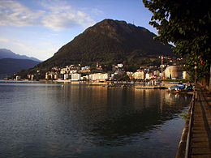
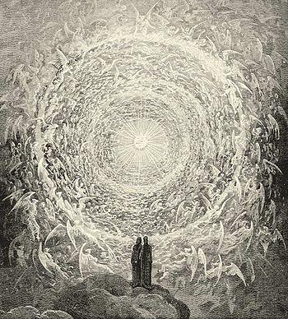
Ci vediamo per la cena!
Hotel Victoria
Via General Guisan 3 - Paradiso
Ci incontriamo a aperitivo
e cena presso
Il ristorante “Le Terrazze”
Hotel Victoria
Via General Guisan 3 – 6900 Paradiso
Dante e Beatrice contemplano l`empireo
(canto XXXI)

